Slide 1
Chapter 2
How to code, test,
and validate a web page
Notes:
<number>

Slide 2
Objectives
The HTML syntax
The CSS syntax
How to use Sublime to work with HTML and CSS files
How to test, debug, and validate HTML and CSS files
Notes:
<number>

Slide 3
The HTML Syntax
Notes:
<number>

Slide 4
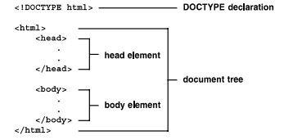
Basic structure of an HTML document
An HTML document contains HTML element that define the content and structure of a web page.
Notes:
Mô tả nội dung chi tiết từng chuyên đề
<number>

Slide 5
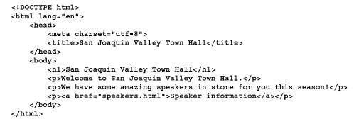
A simple HTML5 document

Slide 6


Code elements and tags
Most HTML element have an opening tag, content, and a closing tag. Each tag is coded within a set of brackets (<>)
Two elements with opening and closing tags
Two empty tags

Slide 7

Code elements and tags (cont.)
Correct and incorrect nesting of tags

Slide 8
How to code attributes
Attributes can be coded within opening or empty tags to optional values
Opening tag with attributes
One attribute:
<a href=“contact.html”>
Three attribute :
<a href=“contact.html” title=“Click to Contact Us” class=“nav_link”>

Slide 9
How to code attributes (cont.)
Empty tag with attributes:
<img src=“logo.gif” alt=“Murach logo”>
Boolean attribute:
<input type=“checkbox” name=“mailList” checked>
Common attributes for identifying HTML elements
Opening tag with an id attribute: <div id=“page”>
Opening tag with a class attribute:
<a href=“contact.html” title=“Click to Contact Us” class=“nav_link”>

Slide 10
How to code attributes (cont.)
Coding rules:
An attribute consists of the attribute name, an equal sign(=), and the value for the attribute
Attribute values don’t have to be enclosed in quotes if they don’t contain spaces
Attribute values must be enclosed in single or double quotes if they contain one or more spaces, but you can’t mix the type of quotation mark used for a single value.
Boolean attributes can be coded as just the attribute name. They don’t have to include the equal sign and a value that’s the same as attribute name.
To code multiple attributes, separate each attribute with a space.

Slide 11
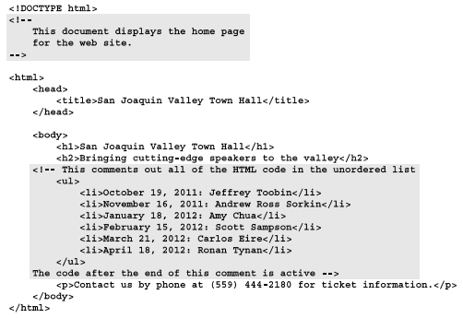
Comments and whitespace
An HTML comment is text that appears between the <!– and → characters.

Slide 12
The CSS Syntax
Notes:
<number>

Slide 13
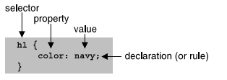
CSS rule sets and comments
A CSS rule set consist of a selector and a declaration block.
A seclector consist of the identifiers that are at the beginning of the rule set.

Slide 14
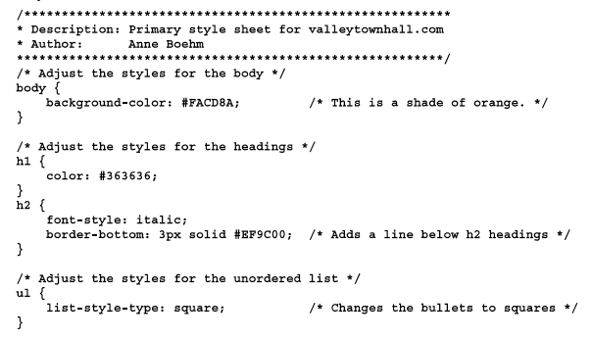
CSS rule sets and comments
CSS comments begin with the characters /* and end characters */.
A CSS comment can be coded on a single line, or it can multiple lines.

Slide 15
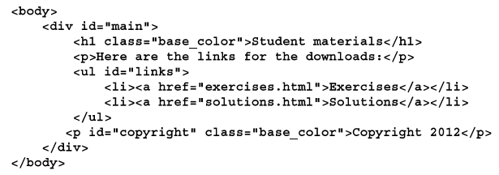
Basic selector
- HTML elements that can be selected by element type, id or class

Slide 16
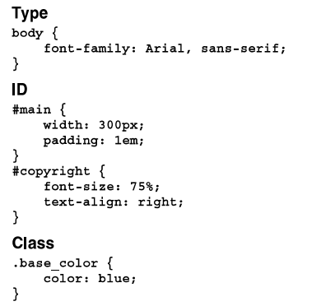
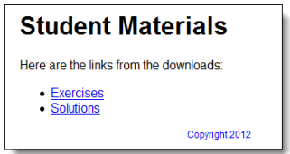
Basic selector
- CSS rule sets that select by element type, id and class
The element in a browser

Slide 17
How to Use Sublime
to work with HTML and CSS files
Notes:
<number>

Slide 18
How to test, debug
and Validate HTML and CSS files
Notes:
<number>

Slide 19
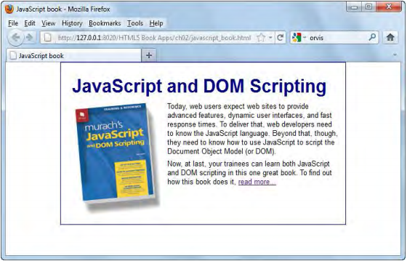
Test and debug a web page
The HTML file displayed in the Fire browser

Slide 20
Test and debug a web page (cont.)
Three way to run a web page that’s on an intranet or your own computer
Rerun a web page from a browser after you change it source code
Test a web page
Debug a web page

Slide 21
Validate an HTML file
To validate the HTML for a page, you can use program or website for that purpose. One of the most popular web sites is the W3C Markup Validation Service.
Use the W3C Markup Validation Service:
http://validator.w3.org/

Slide 22
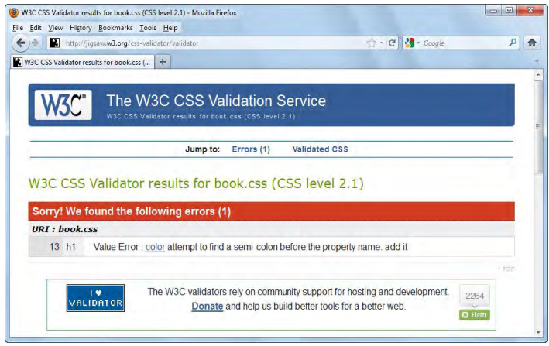
Validate a CSS file
- The CSS validation Service with errors displayed.

Slide 23
Validate a CSS file
Use the W3C CSS Validation Service
http://jigsaw.w3.org/css-validator/

Slide 24
Summary
HTML document, syntax, attribute
CSS rule set, Selector, comment work like HTML document
Test and run HTML file on browser
Validate an CSS or HTML file
Notes:
Tóm tắt lại nội dung đã học
<number>

Slide 25
Discussion
Why we should use CSS for web page?
Notes:
Trả lời câu hỏi WHY?
<number>

